Slide 1
PLATO & ARISTOTLE

Slide 2
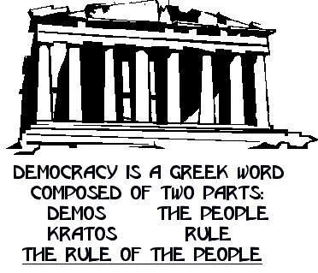
Ancient Greece - Athens - Democracy

Slide 3
Four categories of residents of the ancient Greek citystate
1. Citizens with full legal and political rights
Adult free men born legitimately of citizen parents. They had the right to vote, be elected into office, bear arms, and the obligation to serve when at war.
2. Citizens with legal rights but no political rights:
Women and underage children, whose political rights and interests were represented by their adult male relatives
3. Foreigners (citizens of other city-states):
Full legal rights, but no political rights. Could not vote, could not be elected to office, could not bear arms and could not serve in war. Subject to taxation.
4. Slaves
Property of their owners, any privileges depend on the owner’s will

Slide 4
Play - doh
GREAT POLITICAL PHILOSOPHERS

Slide 5
Plato (428 b.c.-347 b.c.)
Background:
Witnessed the end of the Athenian Republic and the hostile takeover by Sparta
Was a student and disciple of Socrates who influenced his idealistic view of people
Considered Education to be the fundamental influence in creating good citizens
Book: The Republic

Slide 6
Plato (428 b.c.-347 b.c.)
Views on Society:
Considered all war to be fought over money
Believed that all humans are essentially Good, but are inherently different--everyone has different strengths which only education fully develops
Social roles, including leadership, must be based on strengths of the individual
Education instills virtue, integrity, and citizenship

Slide 7
Plato
Plato’s Views on Government:
Believed in a self-sufficient community, led by a Philosopher-king
Educated to lead
instilled with the virtues of philosophy
Unpaid, so uncorrupt-able
Social roles dependent on talent
Responsibility for survival dependent on community collaboration
The “Masses” can be trusted because they are governed by reason, but shouldn’t lead because they have other strengths

Slide 8
Plato Quotes
“Democracy... is a charming form of government, full of variety and disorder; and dispensing a sort of equality to equals and unequals alike.”
“One of the penalties for refusing to participate in politics is that you end up being governed by your inferiors.”
“He was a wise man who invented beer.”

Slide 9
How do you think Plato used this analogy to speak about how a government should be run?
Plato’s Ship Analogy A ship, to accomplish a safe and successful journey, needs an expert navigator at the helm, a captain who knows the capacities of the vessel, geography, meteorology, water currents, navigational astronomy, supplies management, and other related matters. An ignorant and untrained person at the helm of a ship would endanger vessel, cargo, crew, and passengers alike.
Write down the following question and answer it in your notebook

Slide 10
Plato suggests, the ship of state needs expert governors at the helm, governors who are well informed about such things as law, economics, sociology, military strategy, history, and other relevant subjects. Ignorant and incompetent governors can be and have been disasters for citizens and states.

Slide 11
Plato contends that democracy does not work.
Ordinary people have not learned how to run the ship of state.
They are not familiar enough with such things as economics, military strategy etc…,
They are also not inclined to acquire such knowledge.- too much effort and self-discipline.
In their ignorance they tend to vote for politicians who beguile them with appearances and nebulous talk, and they inevitably find themselves at the mercy of administrations and conditions over which they have no control because they do not understand what is happening around them. They are guided by unreliable emotions more than by careful analysis,

